Slide 1
The IAEA’s
Technical Cooperation Programme
The Third National Nuclear Regulatory Conference
Ha Long City, Quang Ninh Province, Viet Nam
Gashaw Gebeyehu Wolde
Division for Asia and the Pacific
Department of Technical Cooperation
July 25, 2018

Slide 2

IAEA Technical Cooperation Programme
Basis for TCP
The IAEA mandate: “ to accelerate and enlarge the contribution of atomic energy to peace, health and prosperity throughout the world”
Role of IAEA
To make a discrete but significant contribution to sustainable development goals to build, strengthen and maintain MSs capacity for using nuclear technology in a safe, secure and sustainable manner

Slide 3
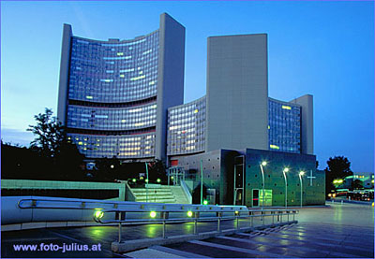
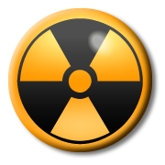
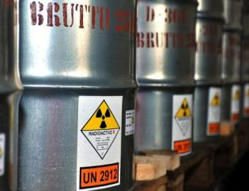
The “Three Pillars” of the IAEA
Safeguards
&
Verification
Safety
&
Security
Science
&
Technology

Slide 4
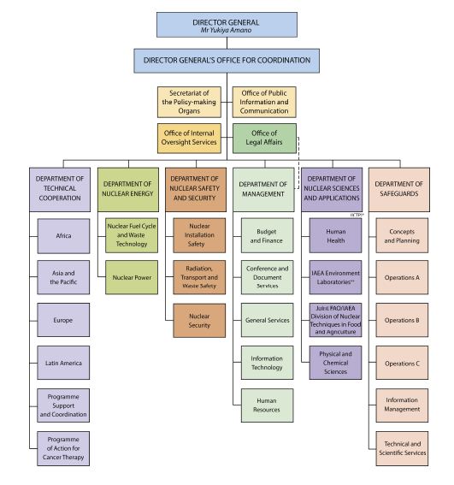
The IAEA – Organization Structure
~ 2560 professional and support staff.
Six Departments
Management
Nuclear Sciences & Applications
Nuclear Energy
Nuclear Safety & Security
Technical Cooperation
Safeguards

Slide 5
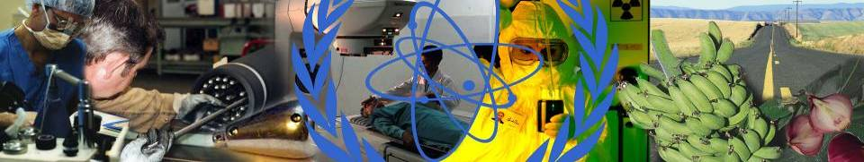
Technical Cooperation Department
Interface between Member States and the Secretariat for technical cooperation assistance financed by the TC Programme
Management of TC Programme with input from technical departments
Vehicle to support programme implementation and monitoring across the IAEA
Regional and country focus rooted in policy priorities of Member States (reflected in Regional Strategies and Country Programme Frameworks)
Notes:
Promoting Science & Technology
The IAEA is working to to fighting poverty, sickness, and pollution of the earth's environment, and to other global "Millennium Goals" for a safer and better future. Some examples of this are listed above. Nuclear technologies reaches into almost every aspect of our daily lives. A few facts are:
Nuclear power generates about 16 percent of the world’s electricity;
Someone receives radioisotope treatment for medical diagnosis every third second; that is 35,000 persons every day;
3 million persons are treated with radiotherapy each year against cancer;
40 countries now use irradiation to improve the hygiene, safety and quality of food;
Radiation is used in scores of industrial applications: sterilizing syringes and other hospital supplies; testing the quality of steel for cars and trucks; and checking for production flaws in airplane engines.

Slide 6
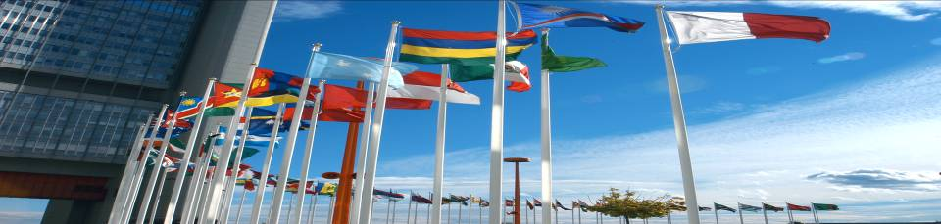
A Strategic Approach to the TC Programme
Driven by the needs of Member State
Based on government commitment – ‘Central Criterion’
Guided by Country Programme Frameworks
Supported by strategic partnerships → synergies for results
Aiming for sustainability and self-reliance

Slide 7
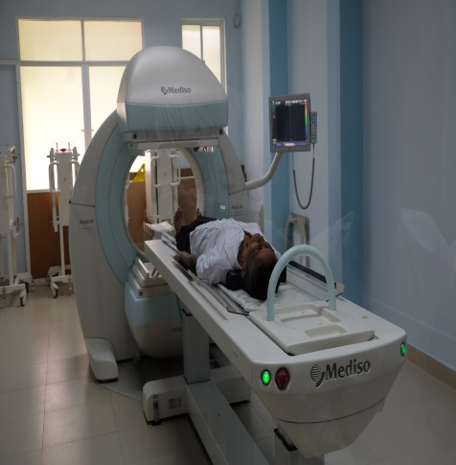
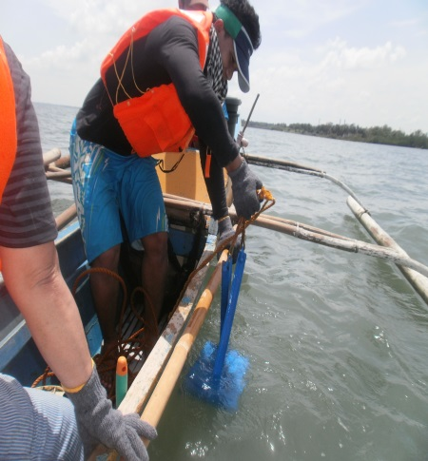
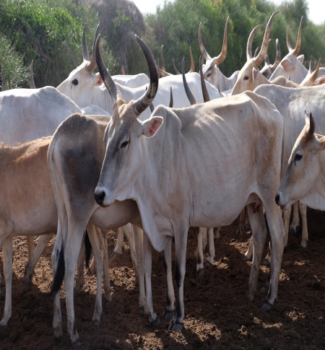
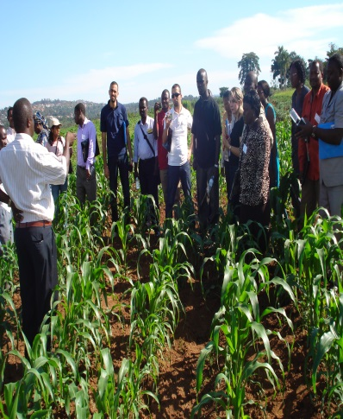
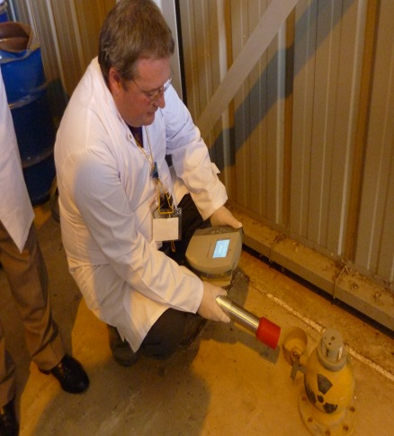
Areas of Support
Food and Agriculture
Human Health and Nutrition
Water and the Environment
Industrial Applications
Energy Planning and Nuclear Power
Nuclear Safety and Security

Slide 8
Core Programme by FoA Cluster 2018-2019 TCP
Notes:
Health and nutrition activities account for the largest portion of the 2018 – 2019 TC programme, at 27%, closely followed by Safety and security at 22% and Food and agriculture at 20%.
NEXT SLIDE

Slide 9

TC Programme 2018-2019
169 IAEA MSs - all are in principle eligible for TC support
Active (~ 800) TC projects
New (579 projects)
Member States and Territories with national TC Programme (136) and territories
Four (4) regions:
        Africa
        Asia & the Pacific
        Europe
        Latin America & the Caribbean

Slide 10
TC Delivery Mechanisms
National
  Infrastructure building
  Address country’s specific needs
  About 60-65% of the programme
  136 Member States and territories
Regional
  Networking and experience sharing
  Address issues of common interest and issues of regional dimension
Interregional
Networking and experience sharing
Address issues of common interest to the four regions

Slide 11
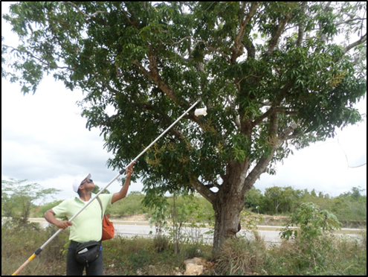
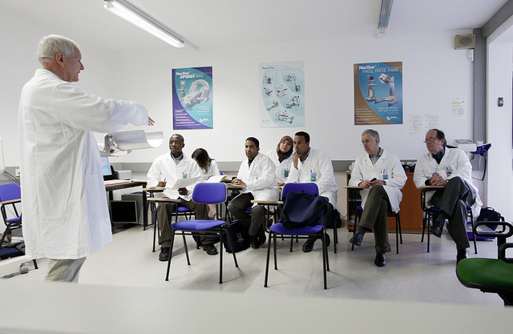
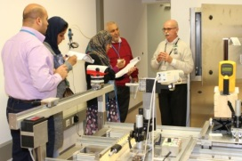
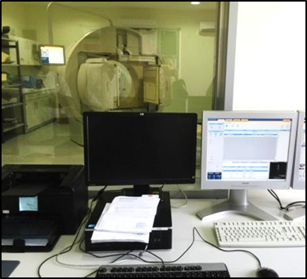
Type of support
Expert advice
Fellowships, Scientific Visits
Workshops, Training Courses
Equipment and Materials

Slide 12
Fellowship Trainings/Scientific Visits
A fellowship is a specially tailored or selected training activity for the purpose of fulfilling special learning objectives.
Scientific visit is awarded to senior staff to broaden the scientific or managerial qualifications of specialists in developing countries.

Slide 13
TC Programme in figures
2016-2017 TCP Cycle
Activity | Number
Individuals recruited | 29 858
Lecturers and experts assigned | 7 418
Regional and INT training participants | 7 027
Meeting participants | 11 733
Fellows and scientific visitors placed | 3 680
Regional and interregional training courses conducted | 419
Purchase orders for procurement issued | 3 534

Slide 14
The Contribution of TC Projects for Strengthening the National Regulatory Infrastructure
in Viet Nam

Slide 15
04 TC Projects of VARANS 2012-2020
VIE9014 (2012-2015): Developing a Nuclear Safety Infrastructure for the First NPP (budget allocated €217,880.29)
VIE9015 (2014-2016): Strengthening the Regulatory Capacity up to the construction permit stage for the first NPPs (budget allocated €222,393.29)
VIE9017 (2016-2018): Enhancing the National Nuclear Regulatory Infrastructure for Effective Regulatory Oversight of the Construction Phase of the First NPP (budget allocated €81,415.00)
VIE9019 (2018-2020): Enhancing Radiation and Nuclear Safety Infrastructure (budget allocated €104,580.00)

Slide 16
Figures of 04 TC Projects of VARANS 2012-2020
Fellowships
Experts advice
Meetings/ Workshops
15 Meetings/ Workshops implemented (in Hanoi, Vienna, overseas)
10 Fe implemented (13 persons trained for 1-3 months, 1 person attending 2 month training at IAEA)
6 Fe planned to implement in 2018-2019
10 expert missions implemented
3 expert missions planned to implement in 2018-2019
Scientific Visits
8 Scientific Visits implemented (34 persons trained) (in Hanoi, Vienna, overseas)
4 SV planned to implement in 2018-2019
Total budget:
€626.268,29

Slide 17
Thematic Safety Areas
National Radiation and Safety Infrastructure
National Regulatory Infrastructure
Radiological Protection in Occupational Exposure
Radiological Protection in Medical Exposure
Public and Environmental Radiological Protection
Emergency Preparedness and Response
Education and Training in Radiological Protection
Transport Safety
Notes:
The Main Thematic Safety Areas for the National Radiation Safety Infrastructure that our projects have been addressing over the years

Slide 18
Achievements of VARANS’s
TC Projects Implemented
Revision of the Atomic Energy Law Accession & Implementation of international legal instruments,
aw
Regulations, (Circulars) Guides on radiation and nuclear safety issued, internal procedures for licensing and inspect developed and implem
Development Regulations (Circulars) on emergency preparedness and response
Human Resources and institutional capacity being developed and Nuclear Safety culture Promoted
Enhanced technical infrastructure and capacity in radiation and nuclear safety, licensing, inspection emergency prep and response,
Establishment of a National Emergency Response Plan
Implementation of Radiological and Nuclear Emergency Preparedness and Response Plan
Strengthened Regulatory Infrastructure for Safety
Notes:
Convention on Nuclear Safety (April 2010);
Convention on the Physical Protection of Nuclear Material (in force Nov 2012) and its Amendment (2012);
Joint Conventions on the Safety of Spent Fuel Management and on the Safety of Radioactive Waste Management (2013)
International Convention on the Suppression of Acts of Nuclear Terrorism (signed: 14 Jul 2016; enforced: 23 Oct 2016)

Slide 19
Reported Achievements of VARANS and TC Projects
Revision of the Atomic Energy Law has been submitted
Accession and implementation of international legal instruments have been effected, NSC 2010, CPPNM, Joint Convention 2013, Conv Nuclear Terrorism 2016,
Various Regulations, (Circulars), Guides on radiation and nuclear safety issued and under implementation, internal procedures for licensing and inspect developed and implemented
Technical capacity development in nuclear safety analysis and assessment, siting e.t.c has been enhanced
Notes:
Nuclear Nonproliferation Treaty (1982);
Convention on Early Notification of a Nuclear Accident (1987);
Convention on Assistance in the Case of a Nuclear Accident or Radiological Emergency (1987);
Safeguards Agreement (1989);
Comprehensive Test Ban Treaty (signed 1996, ratified 2006);
The South East Asia Treaty on the Nuclear Weapon Free Zone (1997);
Code of Conduct on the Safety and Security of Radioactive Sources and Supplementary Guidance on Import and Export of Radioactive Sources (2006);
Additional Protocol (signed in 2007, ratified in Sept 2012).
Convention on Nuclear Safety (April 2010);
Convention on the Physical Protection of Nuclear Material (in force Nov 2012) and its Amendment (2012);
Joint Conventions on the Safety of Spent Fuel Management and on the Safety of Radioactive Waste Management (2013)
International Convention on the Suppression of Acts of Nuclear Terrorism (signed: 14 Jul 2016; enforced: 23 Oct 2016)

Slide 20
Reported Achievements of VARANS and TC Projects
Regulations (Circulars) on emergency preparedness and response have been developed and approved
A national emergency response plan has been established
Technical capacity in emergency response has been enhanced
Emergency response systems in medical facilities have initially been established

Slide 21
Reported Achievements of VARANS and TC Projects
Enhanced technical infrastructure and TSO capacity in radiation and nuclear safety,
The technical support centre for analysing nuclear accidents to support emergency and preparedness response has been established,
Human Resources and institutional capacity being developed and Nuclear Safety Culture Promoted,

Slide 22
Conclusion
The IAEA TC projects made substantive contribution in developing and strengthening the National Regulatory Infrastructure for Radiation and Nuclear Safety in Viet Nam
Strong commitment of key Institutions and the Government maintained throughout the projects’ lifecycle
Close and effective cooperation between VARANS, stakeholders and End-users played an important role in the implementation and achievement of outcomes of the projects.
The Initiative of Viet Nam in promoting Triangular Cooperation with Lao PDR and Cambodia is a highly encouraging step in promoting TCDC.

Slide 23
The Way Forward
In line with the changing policy priorities there is a need to reorient and refocus our TC Projects,
Stream line our current and future projects in order to close the gaps and address the emerging priorities and strengthen the radiation and nuclear safety infrastructure,
We will work to strengthen our cooperation to ensure the effectiveness and sustainability.

Slide 24
Thank you for your attention!

