Slide 1
The 3th National Nuclear Regulatory Conference
Ha Long City, Viet Nam
July 2018
Ronald Pacheco ,
Unit Head, Control of Radiation Sources Unit
Regulatory Infrastructure & Transport Safety,
Division of Radiation Transport and Waste Safety
Department of Nuclear Safety and Security

Slide 2
Content
Importance of a Regulatory System
IAEA support to Member States
Vietnam’s Regulatory situation (IRRS- RASIMS)

Slide 3
Content
Importance of a Regulatory System
IAEA support to Member States
Vietnam’s Regulatory situation (IRRS- RASIMS

Slide 4
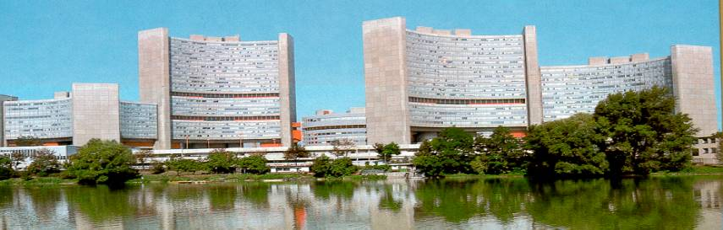
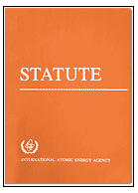
International Atomic Energy Agency
Use of Radiation Technology should not take place if a Regulatory System has not been established and to ensure that Radiation Safety Programs are established to Protect the Workers- Patients- Public and Environment

Slide 5
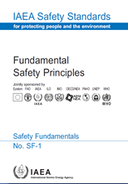
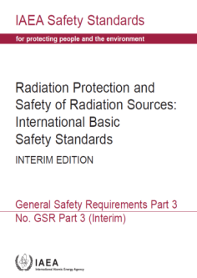
IAEA’S RADIATION SAFETY STANDARDS
IAEA Safety Standards are not legally binding on Member States but may be adopted by them, at their own discretion
however...
IAEA Safety Standards are binding on IAEA in relation to its own operations and to operations assisted by the IAEA; and
Member States receiving IAEA assistance are obliged to apply IAEA Safety Standards

Slide 6
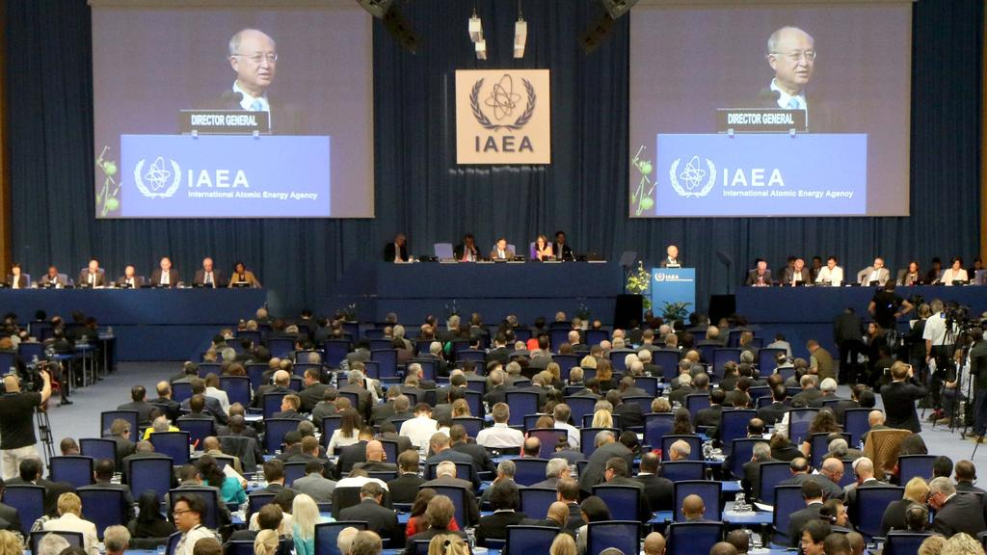
GC and Board of Governors
Board of Governors and General Conference have specifically requested that TC projects involving provision of radiation sources should only be submitted for approval if the country has achieved a certain minimum level of radiation safety

Slide 7


Certain minimum level of radiation safety ?
Complying with the (Board resolutions)
Regulatory Control in Place.
Radiation safety programme in place for the workers, Patients and Public and Environment .

Slide 8
What needs to be done to control use of radiation sources?
Radiation Safety Law
to provide for the legal frame to regulate the use of radiation sources in the country
Establishing
Provided by
Resources
Funds + Staff
Independent Regulatory Body
established by the Law to ensure the implementation of the provisions of the Law
Empowered
Regulations
Register
Licensing
Inspection
Enforcement

Slide 9
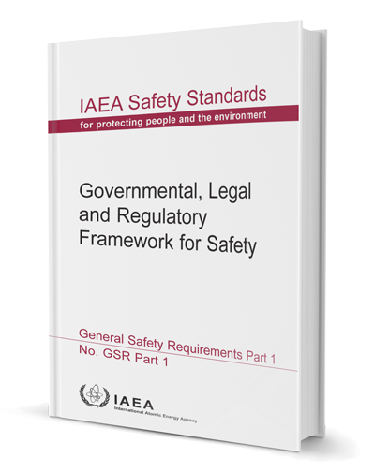
National Regulatory Infrastructure (TSA 1)
Focuses on establishing an independent and functional regulatory infrastructure in a Member State (MS) so that it meets IAEA Safety Standards.
GSR part1
It includes 14 Elements:
Legislation
Regulations and Guidance
Regulatory Body Establishment and independence
Regulatory Body Staffing and Training
Regulatory Body Funding
Coordination and Cooperation and the National Level
International Cooperation
Notification and National Register of Radiation Sources
Authorization
Safety and Security of Radiation Sources
Inspection
Enforcement
Information management
Quality Management
Notes:
First 7 elements focus on Legislative and Statutory Framework.
Second 7 elements focus on Activities of the Regulatory Body.

Slide 10

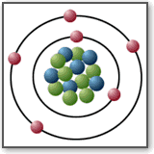
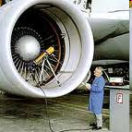
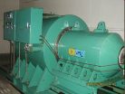

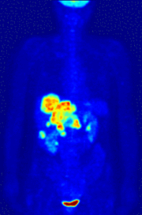
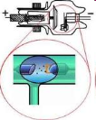





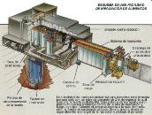


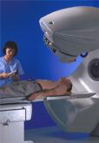






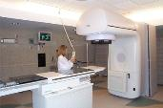



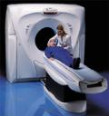

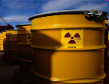


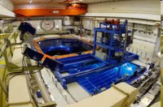


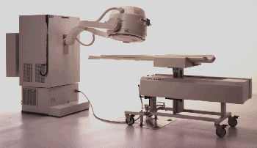

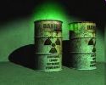
Regulatory and Safety control that covers all uses of radiation sources
Sources of ionizing radiation are widely used in:
  Medicine
  Agriculture
  Industry
  Research and Education
  Security checks
Following the Graded Approach based on Risk

Slide 11
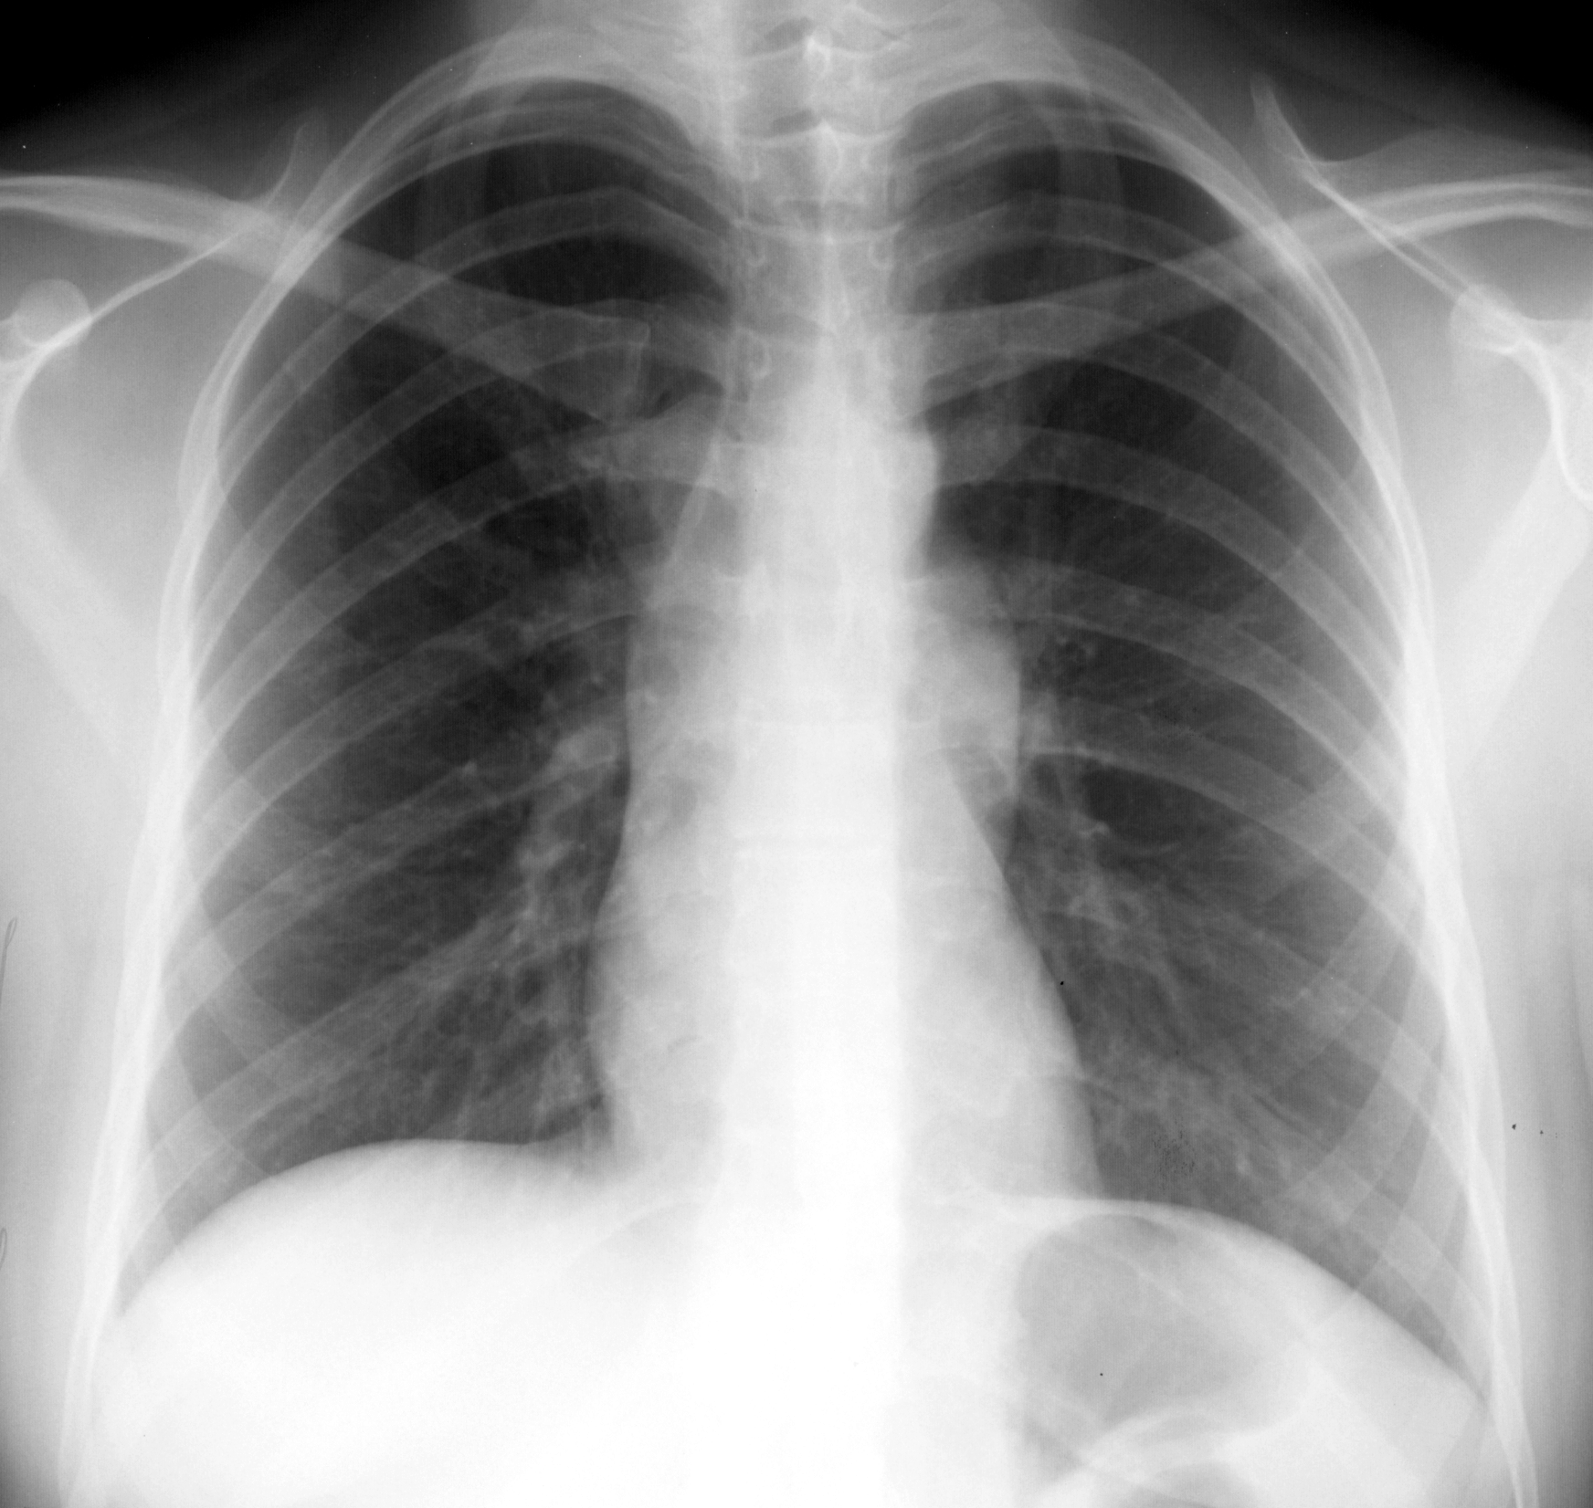
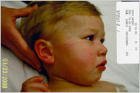
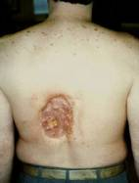
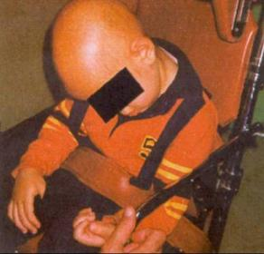
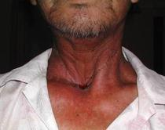
Objectives Regulatory Programme
Avoid Accidents
Good Practices with less doses

Slide 12
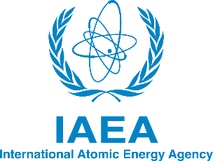

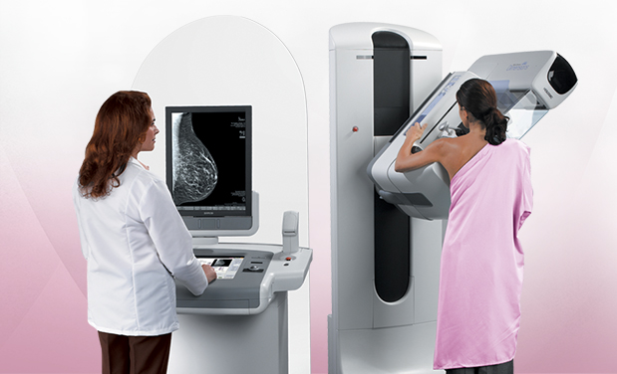
Assessment screening in mammography
3 Countries
80 % of the equipments provided an inappropriate image for a Correct Clinical diagnosis

Slide 13

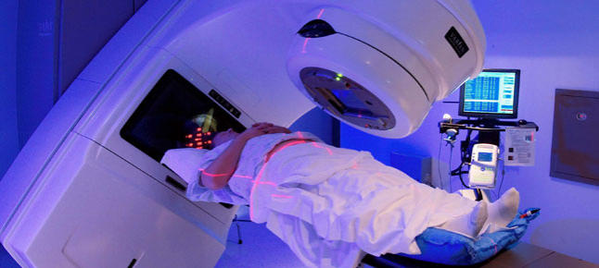

Objective = Ensure Safety
Workers
Patients
Públic

Slide 14
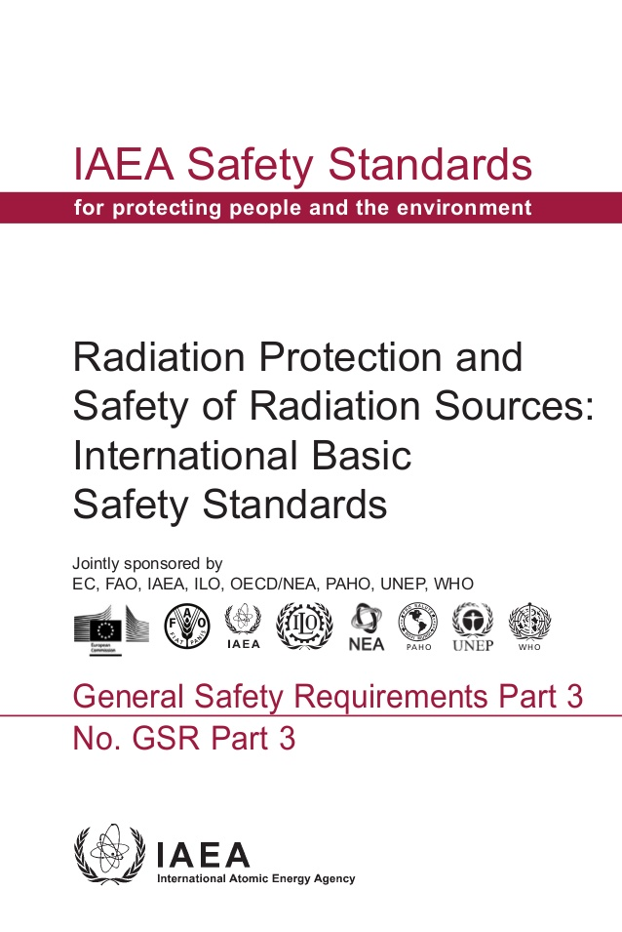
Regulatory Programme should provide adequate requirements
The prime responsibility for safety must rest with the person or organization responsible for facilities and activities.
In the case of medical exposures….., primary responsibility for protection and safety for patients lies with the health professional responsible for administration of the radiation dose.
There is a need for generic justification, to be carried out by the health authority in conjunction with appropriate professional bodies, of a given radiological procedure. This applies to the justification of new technologies and techniques as they evolve

Slide 15
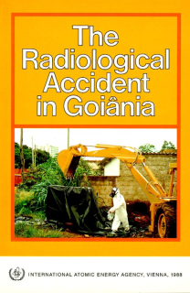
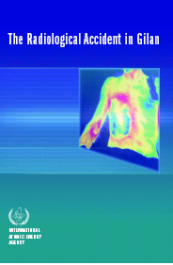
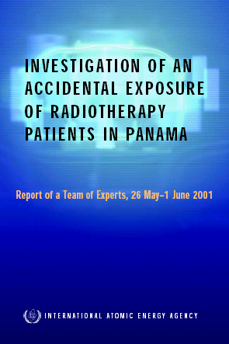
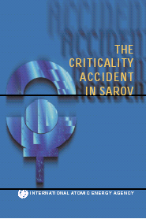
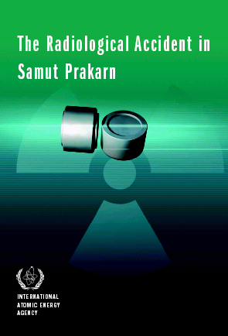
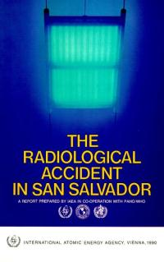
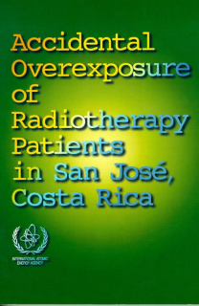
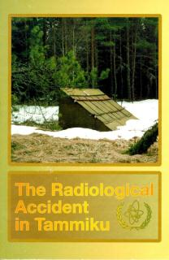
Avoid Radiological accidents

Slide 16
Costa Rica
Miscalibration of beam
115 patients overexposed
Clinical consequences:
64 have Died becouse the overdose
15 overdose to brain and spinal cord with loss of ability to speak , see and walk
People with quadriplegic results
92 with Skin burned
  Severe bloody diarrhea

Slide 17
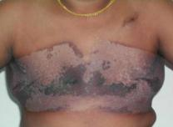
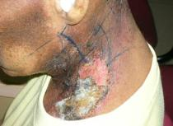
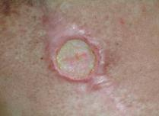
Incorrect repair of accelerator (Spain)
  27 patients were treated using electrons with the faulty equipment
From the 27 patients:
  15 died as a consequence of the overexposure
  Radiation injuries of the lung and spinal cord

Slide 18
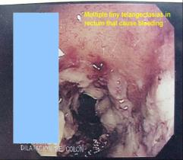
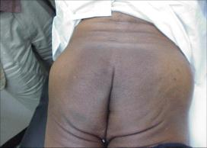
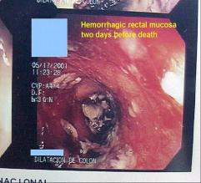
Panama Accident
Error in TPS data entry (Panama)
Effects:
8 deaths of 28 patients
Radiodermitis inflammatory or dystrophic skin processes

Slide 19
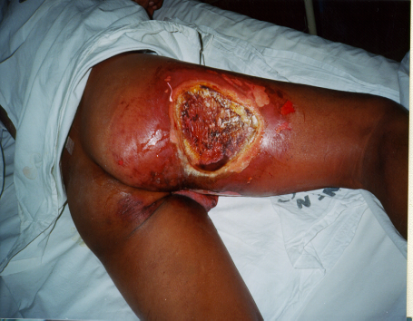
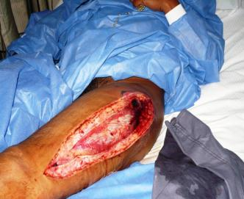
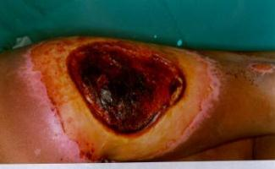
Accidents due to loss of control of sources in Industrial Applications
Small size of source
Generally involve the public; and
Lack of Procedures

Slide 20

Deterministic Effects in Diagnostic Radiology
17 MSs has requested IAEA support on this issue from 2015-2018
Skin damage 18-21 months after this 40 year old patient underwent 2 coronary angiograms and a coronary angioplasty in one day
Estimated skin dose > 20 Gy
Source: Radiation Induced Skin Injuries from Fluoroscopy
Thomas B Shope 1995
USFDA Center for Devices and Radiological Health

Slide 21

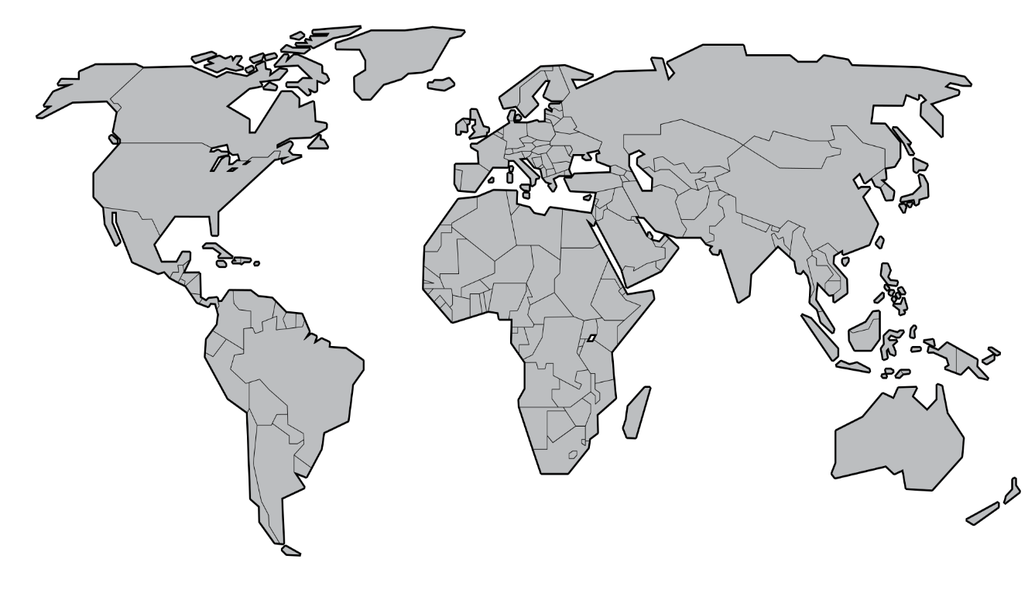
What is the Situation in the World in the establishment of Regulatory Systems ?

Slide 22
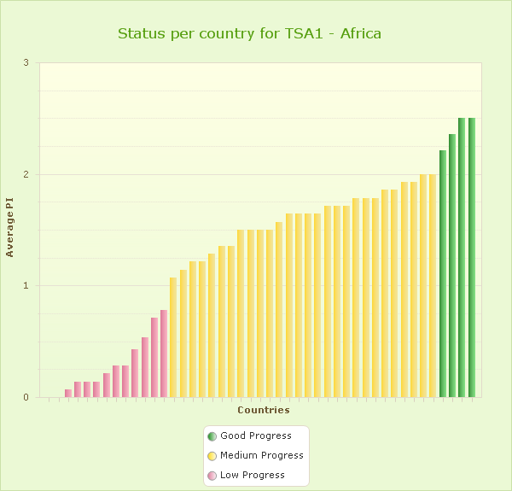
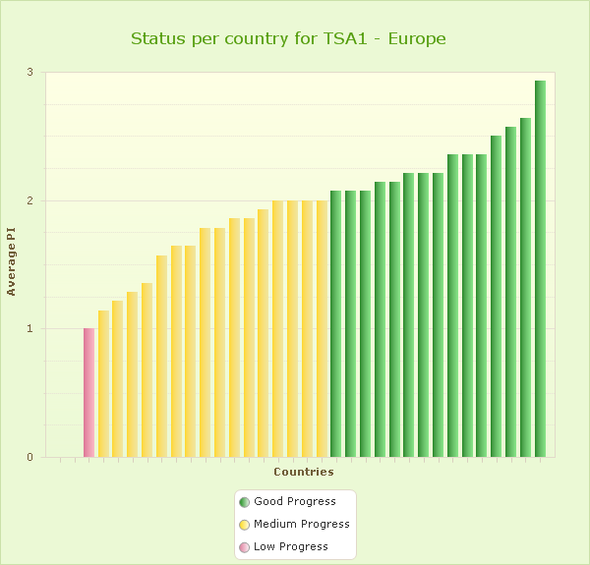
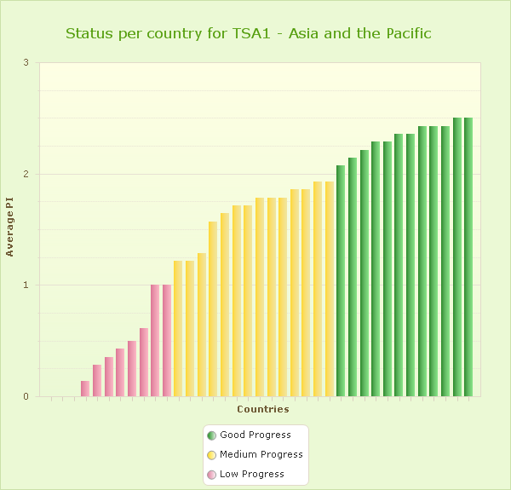
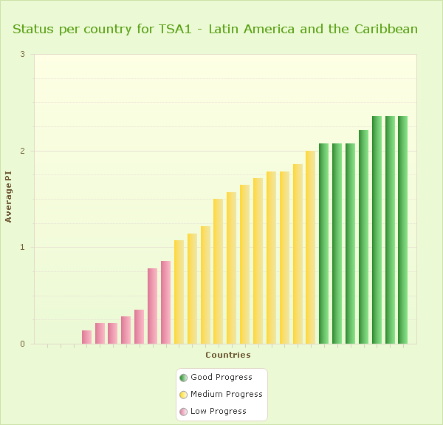
Status of the Regulatory Infrastructure
40% Low Progress

Slide 23
Content
Importance of a Regulatory System
IAEA support to Member States
Vietnam’s Regulatory situation (IRRS- RASIMS

Slide 24

IAEA Safety functions
IAEA Functions in
Radiation & Waste Safety
(Article III.A.6)
INTERNATIONAL MECHANISMS
FOR APPLYING STANDARDS
Rendering
RADIATION
SAFETY
SERVICES
Providing
TECHNICAL
COOPERATION
Fostering
INFORMATION
EXCHANGE
Knowledge
Management &
Networking
Promoting
EDUCATION
& TRAINING
To provide for
the application of
standards
To establish
standards of
safety
TECHNICAL COOPERATION
is the main mechanism and primary strategy
for assisting Member States
in the application of the standards

Slide 25
Safety Standards Categories/Hierarchy
Safety Fundamentals
Safety Requirements
Safety Guides

Slide 26
Structure of the Long Term Set of
Safety Requirements
General Safety Requirements
Specific Safety Requirements
Part 1 Governmental, Legal and
Regulatory Framework
1. Site Evaluation for
Nuclear Installations
Part 2 Leadership and Management
for Safety
2. Safety of Nuclear Power Plants
2.1 Design and Construction
2.2 Commissioning and Operation
B. Design of Nuclear Power Plants
Part 3 Radiation Protection and
Safety of Radiation Sources
Part 4 Safety Assessment
for Facilities and Activities
3. Safety of Research Reactors
Part 5 Predisposal Management
of Radioactive Waste
4. Safety of Nuclear Fuel
Cycle Facilities
Part 6 Decommissioning and
Termination of Activities
5. Safety of Radioactive Waste
Disposal Facilities
Part 7 Emergency Preparedness
and Response
6. Safe Transport of
Radioactive Material

Slide 27
National Regulatory Infrastructure (TSA 1)
GSR part1
Focuses on establishing an independent and functional regulatory infrastructure in a Member State (MS) so that it meets IAEA Safety Standards.
It includes 14 Elements:
Legislative and Statutory Framework
Legislation
Regulations and Guidance
Regulatory Body Establishment and independence
Regulatory Body Staffing and Training
Regulatory Body Funding
Coordination and Cooperation and the National Level
International Cooperation
Activities of the Regulatory Body
Notification and National Register of Radiation Sources
Authorization
Safety and Security of Radiation Sources
Inspection
Enforcement
Information management
Quality Management
Notes:
First 7 elements focus on Legislative and Statutory Framework.
Second 7 elements focus on Activities of the Regulatory Body.

Slide 28


Processes for
Notification
Authorization
Inspection
Enforcement
Graded Approach

Slide 29

Regulatory Body organization and Structured to cover all responsibilities.
Integrated Management System

Slide 30

This Safety Guide provides recommendations on meeting the safety requirements concerning communication and consultation with the public and other interested parties by the regulatory body about the possible radiation risks associated with facilities and activities, and about processes and decisions of the regulatory body

Slide 31

Provide guidance on the establishment of the national radiation safety infrastructure that meets the IAEA safety standards

Slide 32




Slide 33




NEW TECDOC on Notification, Authorization, Inspection and Enforcement for the Safety and Security of Radiation Sources (Draft version)
First IAEA TECDOC addressing the implementation of safety and security requirements in a harmonized way
Is intended to provide practical guidance on how to implement IAEA Safety Requirements and applicable IAEA Nuclear Security Series guidance
NEW TECDOC does not replace IAEA TECDOC 1525 and TECDOC 1526 on notification and authorization, and on inspection and enforcement

Slide 34

Code of Conduct Goals
  1. to achieve and maintain a high level of safety and security
  2. to prevent loss of control
  & malicious use
  3. to mitigate or minimize the radiological consequences of any accident or malicious act

Slide 35


Code of Code Contents
Set of Principles, Objectives and Guidance to ensure Safety and Security of sources
Focuses on high activity sources
NOT part of the Safety Standards or Nuclear Security Guidance
Main target audience: Governments and Regulatory Bodies

Slide 36



Code and Supplementary Guidance
  States should have effective national legislation, regulations and a regulatory body and
  Effective import/export controls: supplementary Guidance on the Import and Export of Radioactive Sources, 2004
Safe and secure management of disused RS:
  supplementary Guidance on the Management of Disused Radioactive Sources, 2017
Notes:
Code provisions are aimed to ensure that States have effective national legislation, regulations and a regulatory body, effective import/export control of radioactive sources and system to ensure safe and secure management of the disused radioactive sources. As States recognize that radioactive sources when they are transferred and when they have become disused need special regulatory attention – 2 supplementary Guidance were developed, approved by the Board of Governors and endorsed by the General Conference:
In 2004 (now 2012 edition is in force) Guidance on the Import and Export of Radioactive Sources;
In 2017 Guidance of the Management of Disused Radioactive Sources.

Slide 37

Why additional Guidance?
Insufficient regulatory control of disused radioactive sources is globally recognised as a root cause of major severe accidents
The 2013 International Conference recommended that “additional guidance at the international level for long-term management of disused
radioactive sources” be developed

Slide 38

Guidance content
National policy and strategy for the management of disused sources
Legislation and regulations
Regulatory body roles and responsibilities
Short-term storage
Transport, transit and
transshipment
Options for the management
of disused sources
Management of orphan sources
International and
regional cooperation
  Orphan source
  France, Sudan and Ukraine are the first countries to have expressed their political commitment

Slide 39

New Training Packages for Regulators
“Regulatory Infrastructure for the Safety of Radiation Sources and Security of Radioactive Material”.
“Training on Safety Assessment for Regulators”.
“Training on Regulatory aspects on Scrap Metal”.
“ Training on regulatory Control of Cyclotrons and PET-CT.
“Leadership on Safety”

Slide 40
Content
Importance of a Regulatory System
IAEA support to Member States
Vietnam’s Regulatory situation (IRRS- RASIMS)

Slide 41


Slide 42








Thematic Safety Areas:
    TSA 1: Regulatory Framework
    TSA 2: Occupational Radiation Protection
    TSA 3: Patient Radiation Protection
    TSA 4: Waste Safety & Public Protection
    TSA 5: Emergency Preparedness and Response
    TSA 6: Education and Training
    TSA 7: Transport Safety
Notes:
In the next 10 minutes .I will be covering the following points :
1. This system is one of the outcome form the recommendation of the advisory group .
2. I will also talk about the main components or modules of the IMSIMS
3. From these modules , I will be focus on the explaining our idea for receiving the feed back from the application of the Safety Standards , which is so far under development .
4. We will also be having a quick look at the prototype.
5, Finally , what is the current status of the system and its project plan .

Slide 43


Slide 44


Legal and Regulatory Infrastructure
TSA 1
Ensuring appropriate legislation and regulations in addition to an effectively independent regulatory body, with sufficient staffing and funding, which is empowered to conduct its regulatory functions effectively.
New Strategic Approach
1.Assessment of national needs for establishing and strengthening radiation safety
2.Design of a national programme to address the needs
3.Implementation of the national programme
4.Evaluation of effectiveness of the national programme

Slide 45


Slide 46


Slide 47


IRRS
IRRS 2010
89 Recommendations
47 Suggestions
Follow-up IRRS 2014
44 recommendations
28 suggestions

Slide 48





Follow-Up IRRS mission 2014 (OPEN FINDINGS)
Legal and Governmental Responsibilities
3 Recommendations
2 Suggestions
Responsibilities and Functions of the Regulatory Body
3 Recommendations
5 Suggestions
Activities and Functions of the Regulatory Body
11 Recommendations
3 Suggestions
Medical Exposure
4 Recommendations
4 Suggestions
Emergency
13 Recommendations
2 Suggestions

Slide 49




Occupational Radiation Protection Program TSA 2
It focussed on the protection of occupationally exposed workers against the risks associated with ionizing radiations in all exposure situations.
New Strategic Approach
1.Assessment of national needs for establishing and strengthening radiation safety
2.Design of a national programme to address the needs
3.Implementation of the national programme
4.Evaluation of effectiveness of the national programme

Slide 50


Slide 51


Slide 52


Radiation Protection in Medical Exposure TSA 3
It focused on promoting and enhancing optimization programmes and strategies to avoid unnecessary exposure to patients and the prevention of accidents in accordance with the requirements of the International Safety Standards.
New Strategic Approach
1.Assessment of national needs for establishing and strengthening radiation safety
2.Design of a national programme to address the needs
3.Implementation of the national programme
4.Evaluation of effectiveness of the national programme

Slide 53


Slide 54


Slide 55


Public and Environmental- Waste Radiological Protection TSA 4
New Strategic Approach
1.Assessment of national needs for establishing and strengthening radiation safety
2.Design of a national programme to address the needs
3.Implementation of the national programme
4.Evaluation of effectiveness of the national programme
Has the aim of ensuring that people and the environment are adequately protected from the adverse effects of radiation both now and in the future. Clearly defines policies for clearance from regulatory control, discharge control, and management and disposal of radioactive sources once they have become disused.

Slide 56


Slide 57


Slide 58


Emergency Preparedness & Response TSA 5
It focuses on strengthening and harmonising national and international capabilities for preparing and responding to nuclear and radiological emergencies
New Strategic Approach
1.Assessment of national needs for establishing and strengthening radiation safety
2.Design of a national programme to address the needs
3.Implementation of the national programme
4.Evaluation of effectiveness of the national programme

Slide 59


Slide 60


Slide 61



Education and Training
Radiation Safety
It focusses on the development of a national strategy for education & training for radiation, transport & waste safety in line with the strategic approach provided to the IAEA Board of Governors and General Conference (IAEA/2010/Note 44).

Slide 62


Slide 63


Slide 64


Safe transport of radioactive material TSA 7
IT Focuses on improvement of the transport network to support the safe and reliable transport of radioactive materials and reduction of denial of shipments.
New Strategic Approach
1.Assessment of national needs for establishing and strengthening radiation safety
2.Design of a national programme to address the needs
3.Implementation of the national programme
4.Evaluation of effectiveness of the national programme

Slide 65


Slide 66


Slide 67



Team Work

Slide 68


VIE9019
Notes:
VIE9019

Slide 69


Slide 70

Concept 2020-2021

Slide 71

Thank you!
Notes:
Thank you!

