Slide 1
Regulatory inspection and enforcement of radiation activities and nuclear facilities in Slovenia
Zoran Petrovič
Slovenian Nuclear Safety Administration
The 3rd National Nuclear Regulatory Conference of Viet Nam, Ha Long City, July 2018

Slide 2
Content of the presentation
Introduction
Facilities and activities in Slovenia
Slovenian Nuclear Safety Administration
Legislation
Inspection and Enforcement
Examples of Inspection and Enforcement

Slide 3
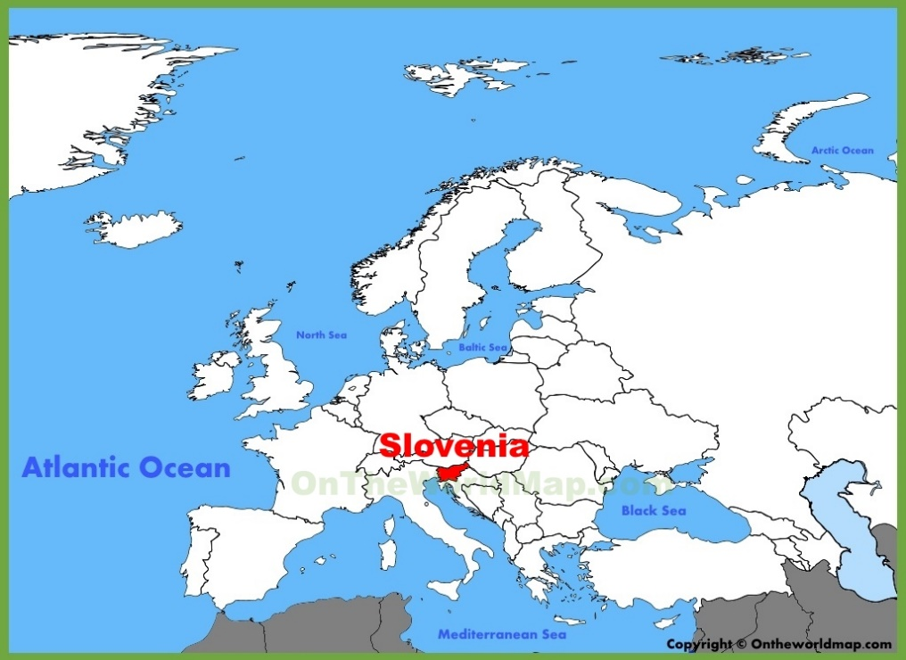
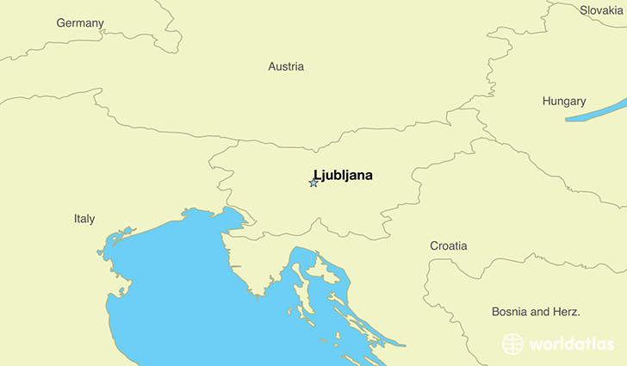
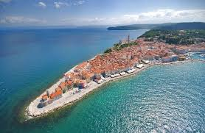
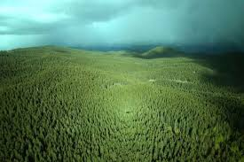
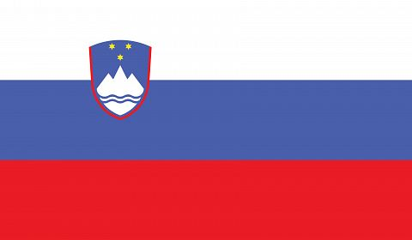
Slovenia – country in the heart of Europe
Centraleuropean Country
EU Member since 2004
Government Type:
Parliamentary Republic
Land Area: 20.151 km sq.
Population: 2.066.000
Capital: Ljubljana-300.000

Slide 4
But Slovenia is:
… The smallest nuclear country…
… We have everything the big country has …
… And we have to manage it with less resources…
…To reach our main goal: „To prevent unnecessary radiation of personnel and population!“

Slide 5
Facilities in Slovenia
Hungary
Austria
IRRADIATOR
Žirovski vrh
Research
Krško
uranium mine
reactor
Italy
Central interim
nuclear
storage for
power-plant
LJUBLJANA
radioactive waste
Croatia
Adriatic
Sea

Slide 6
Krško NPP
Westinghouse PWR, 2 loop, 700 Mwe.
Commercial operation since 1983.
Ownership: 50% - Slovenia 50% - Croatia.
Modernization in year 2000
  12 to 18 months fuel cycle.
  Uprate for 6,3%.
Design life time until 2023
  Operation for additional
  20 years is foreseen.

Slide 7
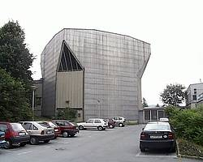
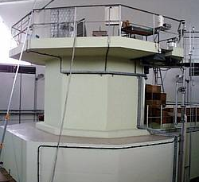
TRIGA research reactor
TRIGA Mark II– research reactor
at the “Jožef Stefan Institute”;
running for 50 years.
TRIGA – training, research, etc.
Important for maintaining expert
infrastructure in the country.
Life time extended until 2026.
Production RF for NM (past).
1999 – SF transported in USA.

Slide 8
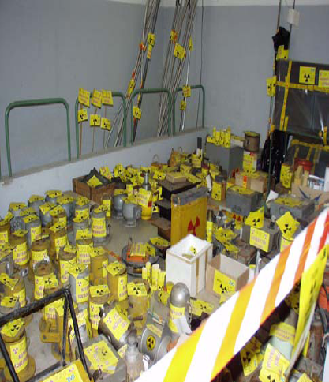
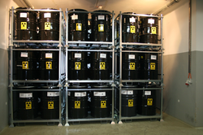
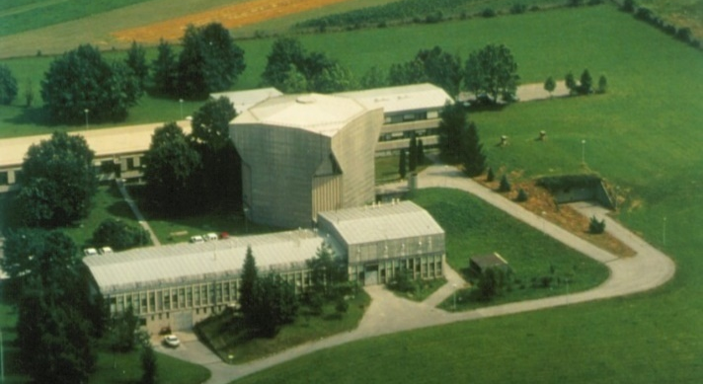
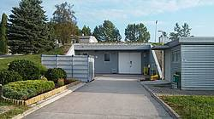
CSRAO – Radioactive Waste Storage Facility
CSRAO - the central storage for radioactive waste
(the only one in Slovenia; near capital).
Run by the Agency for Radioactive
Waste (RW) Management.
Accepts RW from small producers
(not from Krško NPP!).
Renovated in 2004.

Slide 9
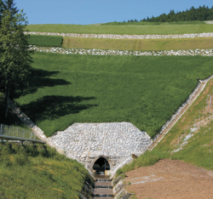
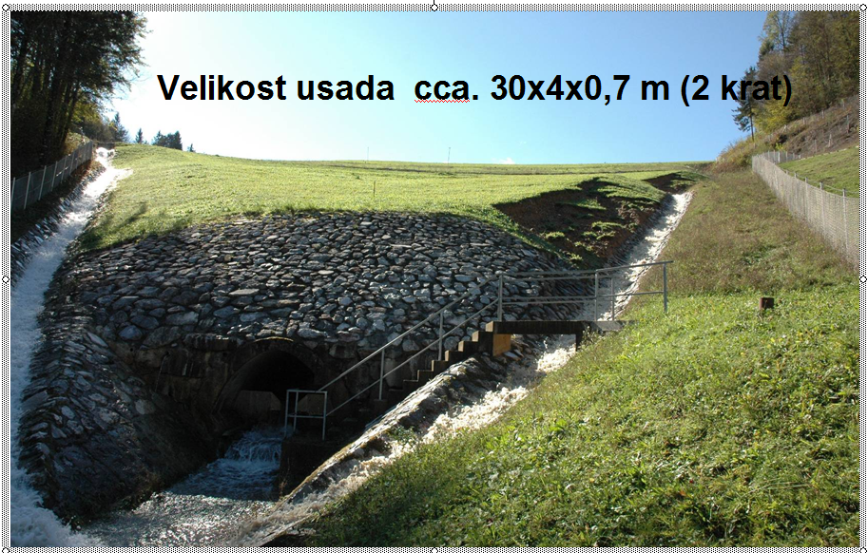
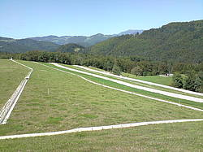
Žirovski vrh mine
Former uranium mine in a decommissioning phase.
  In past nuclear, now radiation facility.
Repository Of Mine Tailings Jazbec:
  Remediation in the field finished in 2005.
  Status: Closed.
  Activities: Long term monitoring
  and maintenance - run by ARAO (public agency).
  Repository of hydro-metallurgical
  tailings Boršt - Remediation in progress;
  Status: Closing.

Slide 10
Radiation practices/activities in Slovenia - medicine and veterinary not included
Radiation practices/activities - in approx. 350 org.:
  destructive testing, automatization and processing techniques, research, density and moisture measurements, education, radiation monitoring, scrap metal yards, outside workers, etc.
About 1200 sources are being used in Slovenia
  more than 700 radiation sources (mainly SRS) and more than 350 X-ray devices, etc.
SNSA is responsible for registers:
  radiation practices, for radiation practices, for facilities (nuclear, radiation).
Inspection on radiation practices and use of SRS and transport of RAM.
Oversight on radiation sources „From Cradle to Grave!“

Slide 11
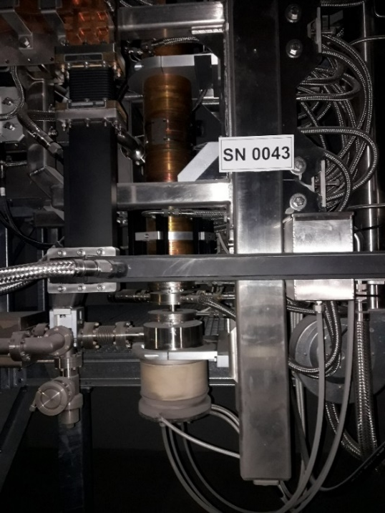
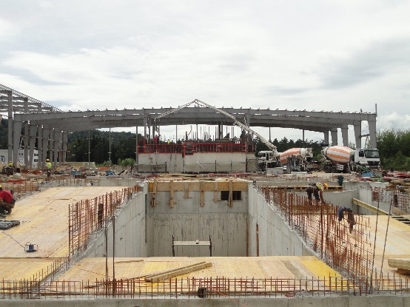
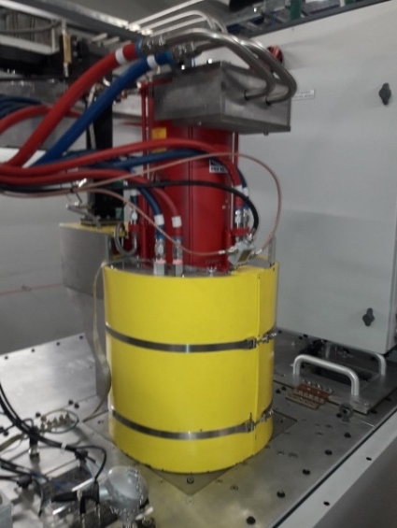
Linear accelerators – not for patient treatment
New radiation facility constructed in 2017/2018;
  For sterilization of medical accessories; 2 linear accelerators arranged in series; opposite positioned.
SNSA issued design basis for facility in accordance with SLO regulation and IAEA requirements - IAEA SSG-8 Radiation Safety of Gamma, Electron and X Ray Irradiation Facilities.
Licensing process completed after
inspection and enforcement!

Slide 12
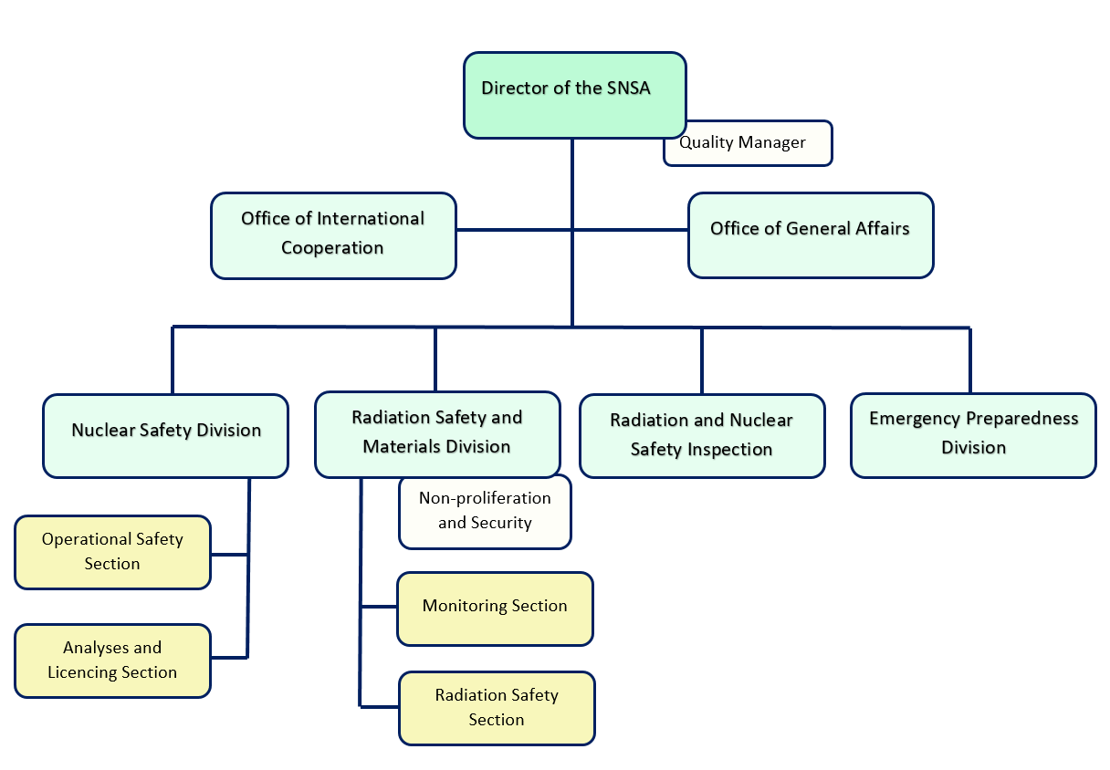
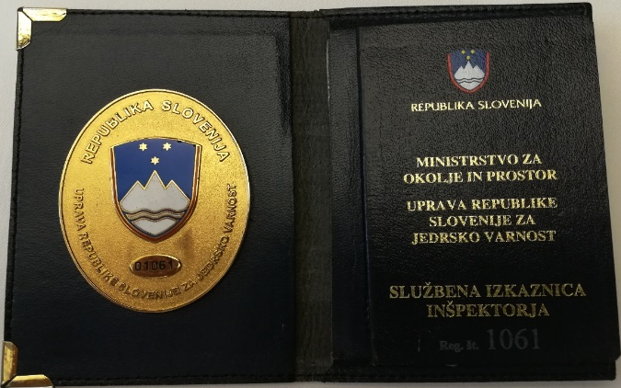
SNSA – Organigram
Established in 1988.
43 employees, 5 are inspectors.

Slide 13
Slovenian Nuclear Safety Administration - Tasks
Administrative and inspection tasks over:
  nuclear facilities,
  radiation facilities,
  companies or persons performing radiation activities,
  use of radiation sources,
  nuclear materials and nuclear non-proliferation,
  environmental monitoring.
Preparation of legislation.
Emergency Preparedness and Response - in a case of nuclear or radiological emergency (all staff involved).
Contact point according to international agreements.

Slide 14
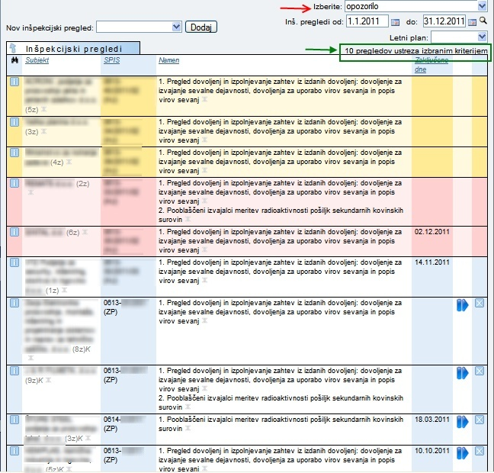
Inspection - key elements
Inspection plan is prepared annually - graded approach in selecting areas and activities:
  Includes all facilities, frequencies, requirements for inspection staff, inspection areas and activities.
  Prepared in accordance with SNSA procedure: „Implementation of inspection control“.
Inspections types: Planned: announced, unannounced
Unplanned: reactive inspections.
Officer on Duty: 24/7 – all inspectors.
Inspection modul – Inspection Tracking System:
Transparency on inspector‘s work, quick transfer
of inspection records and findings, easy obtaining
data for statistics, etc.
Automatically generates e-mails to inspectors -
notify about deadlines for
corrective actions implemetation.

Slide 15
Inspection and Enforcement - Legislation
Act on Protection against Ionizing Radiation and Nuclear Safety – Atomic Act:
  Significant number of governmental decrees and regulations.
  Every practice or facility has to be licensed.
Inspection Act.
Minor Offences Act.
Criminal Code.
Act on Administrative Procedure.
Transport of Dangerous Goods Act.
SNSA inspectors co-operate with police (MIA) on the Physical Protection of Nuclear Facilities and Material inspections, according to appropriate legislation.

Slide 16
Inspection and Enforcement
Inspectors have a special powers and responsibilities to act in the field – given by Inspection Act.
Inspection Act – determine conditions to become an inspector; inspectors are obliged to pass state exam.
Inspection act is prescribing also inspection procedures, inspection measures and other issues relating to inspection.
Atomic Act is specifying violations to be enforced.
Enforcement is not the prime tool for SNSA inspectors.
We use softer methods where cooperative customers are improving by themselves without enforcement,
(if appropriate).
Intensive and constructive communication is necessary.

Slide 17
Inspection and Enforcement
Graded Approach on enforcement actions is taken into account.
Enforcement actions are covered by legislation in force:
  warnings (oral or written),
  inspector requests for corrective action on identified non-conformances or discrepancies,
  stop of specific activity,
  penalties,
  suspension of operation,
  revoke of authorization.
  Criminal Act – inspector has the right and duty to announce a criminal offense or to give a criminal complaint.

Slide 18
Inspection findings evaluation process
For minor non-conformances evaluation is done by inspector:
  corrective actions are required immediately,
  written in the report together with deadlines.
Process on serious/important findings follows by procedure:
  inspector reports findings to the director of inspection division,
  findings are introduced to the SNSA management by the director of inspection division and/or inspector,
  if needed, SNSA expert group is appointed for further evaluation of findings for determination of SNSA actions,
  if applicable, further SNSA analyses are performed (as root cause…, PSA),
  if needed, team inspections are performed to obtain additional inputs to SNSA analyses.
Other violation - announcement to competent inspectorate.

Slide 19
Inspection and Enforcement - 1: Overexposure of workers in industrial radiography
At Thermal PP a NDT of welds was performing.
Radiation source (SRS) was jammed during
positioning in safe position in camera.
Two workers tried to fix the problem.
Not used dedicated procedures (notify RPO).
Suspicion that audio alarms were switched off.
In app. 5 minutes of positioning SRS.
Monthly effective dose exceeded 20 mSv.
Significant inspection finding –>
Enforcement actions:
Stopping activities with 2 cameras - Atomic act.
Penalty was issued - Minor Offences Act.
Verification of all NDT cameras were performed.

Slide 20
Inspection and Enforcement: Scrap Metal -1
Generally, being implemented to control of illegal or unintentional transport of radioactive materials.
SNSA and inspectors co-operate with border police and custom - those are equipped with radiation detectors and meters.
Portal monitors were installed on main border crossing and at the port.
Since 2008:
  Importers/other have to measure every shipment of scrap metal.
  No import without report that shipment not exceed NBR.
Since 2018:
  Radiation detecting system shall be installed at significant nodal transit points (postal centers, airports, ports).

Slide 21
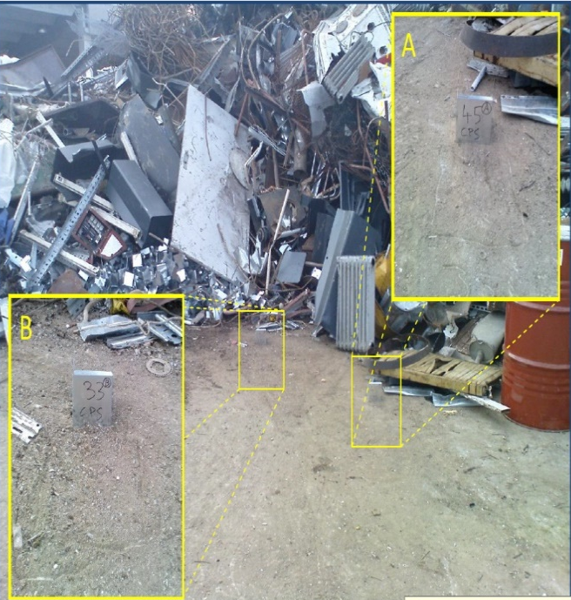
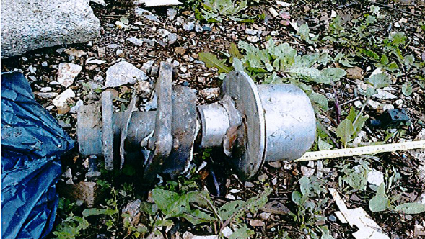
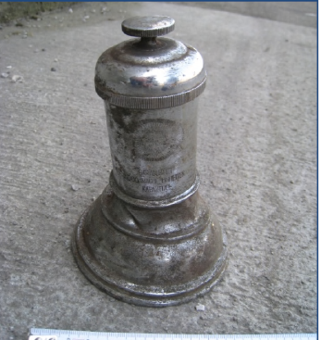
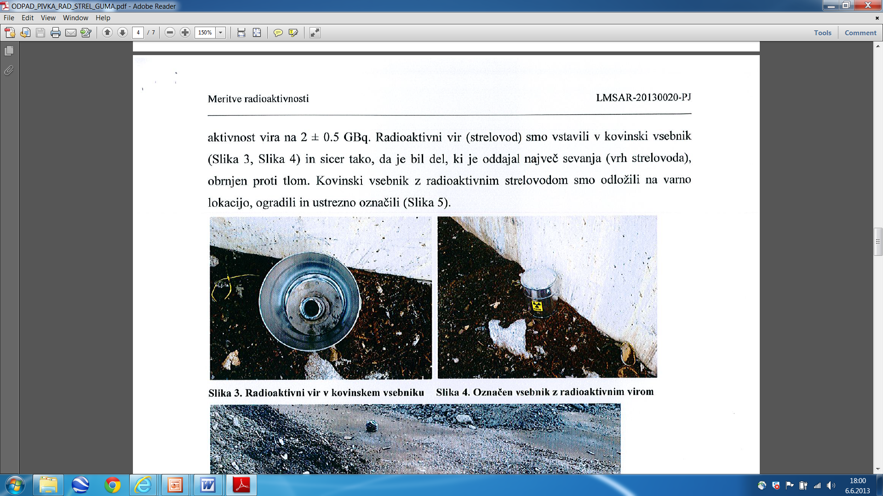
Inspection and Enforcement: Scrap Metal -2
Inspector use, among others, Governmental decree on checking the radioactivity of shipments of scrap metal (2008).
Slovenia does not want to have foreign DSRS, RW,… so inspectors do not allow entrance to Slovenia. Some examples:
Radium Life Ground dust Lightening rod
radon in drinking water TENORM was 40 mSv/h; after 0,2 mSv/h

Slide 22
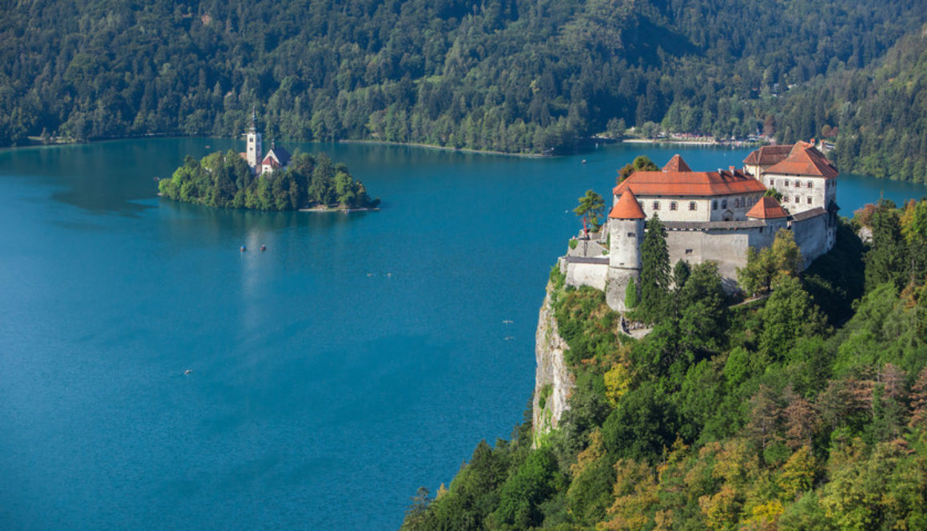
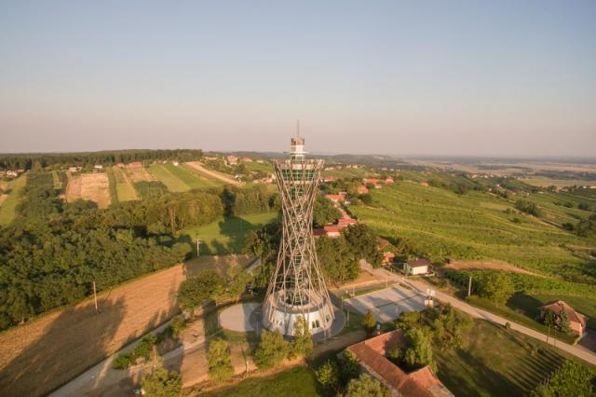
Thank you for your attention!
Cám ơn vì sự quan tâm của bạn!

